Slide 1
Database: SQL vs NOSQL
By: Anusha
Ruchika
Rithika
Sanmati
Sreelakshmi

Slide 2
Data
Data is nothing but facts related to any object . It is facts and statistics stored or free flowing over a network , generally it’s raw and unprocessed . Name, age, height, weight, etc are some data . A picture , image , file , pdf etc can also be considered data.
Data becomes information when it is processed, turning it into something meaningful.

Slide 3
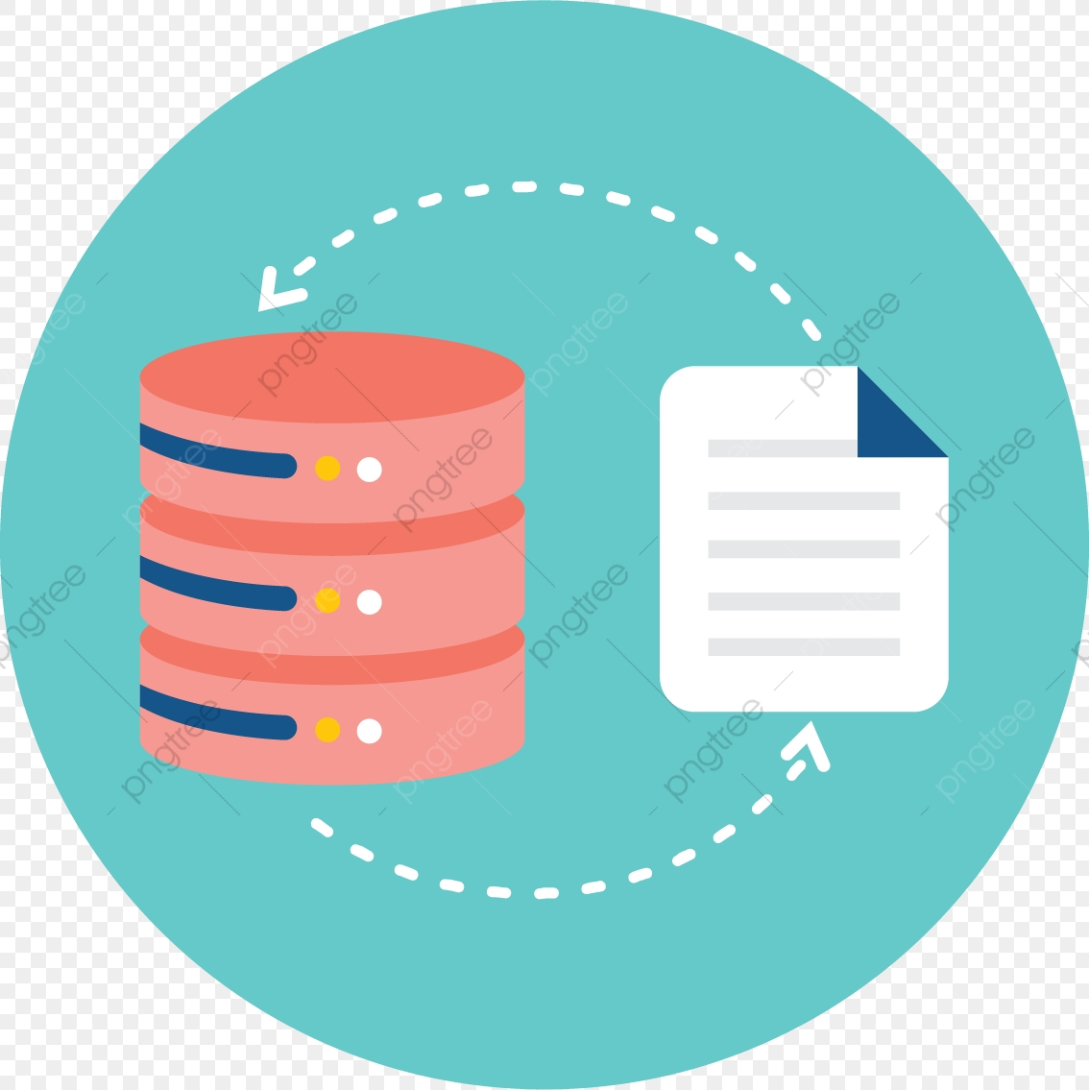
Database
A database is an organized collection of data, generally stored and accessed electronically from a computer system.
Databases support storage and manipulation of data. Databases make data management easy.
Examples
Let's consider facebook. It needs to store, manipulate and present data related to members, their friends, member activities, messages, advertisements and lot more.
An online telephone directory uses database to store data pertaining to people, phone numbers, other contact details, etc.
Electricity service provider uses database to manage billing , client related issues, to handle fault data, etc.

Slide 4




Databases

Slide 5
DBMS
A database management system (DBMS) is a software package designed to define, manipulate, retrieve and manage data in a database.
DBMS examples include:
MySQL
SQL Server
Oracle
FoxPro

Slide 6
Types of DBMS
Relational database
Text database
NOSQL and object oriented database
Desktop database
Notes:
Types of Databases
The simplest form of databases is a text database. When data is organized in a text file in rows and columns, it can be used to store, organize, protect, and retrieve data. Saving a list of names in a file, starting with first name and followed by last name, would be a simple database. Each row of the file represents a record. You can update records by changing specific names, you can remove rows by deleting lines, and you can add new rows by adding new lines.
Desktop database programs are another type of database that's more complex than a text database but intended for a single user. A Microsoft Excel spreadsheet or Microsoft Access are good examples of desktop database programs. These programs allow users to enter data, store it, protect it, and retrieve it when needed. The benefit of desktop database programs over text databases is the speed of changing data, and the ability to store large amounts of data while keeping performance of the system manageable.
Relational databases are the most common database systems. They include databases like SQL Server, Oracle Database, Sybase, Informix, and MySQL. The relational database management systems (RDMS) feature much better performance for managing data over desktop database programs. For example, they allow multiple users (even thousands!) to work with the data at the same time, creating advanced security for access to the data. RDBMS systems store data in columns and rows, which in turn make up tables. A table in RDBMS is like a spreadsheet. A set of tables makes up a schema. A number of schemas create a database. Many databases can be created on a single server.
The most innovative structures for storing data today are NoSQL and object-oriented databases. These do not follow the table/row/column approach of RDBMS. Instead, they build bookshelves of elements and allow access per bookshelf. So, instead of tracking individual words in books, NoSQL and object-oriented databases narrow down the data you are looking for by pointing you to the bookshelf, then a mechanical assistant works with the books to identify the exact word you are looking for. NoSQL specifically attempts to simplify bookshelves by storing data in a denormalized way; this means storing it in large chunks.

Slide 7
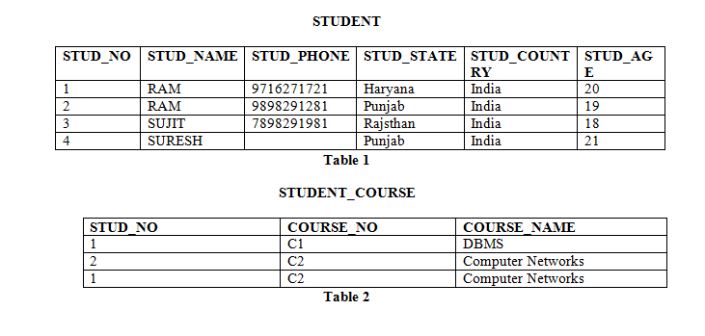
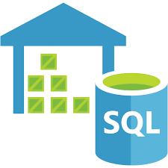
DATABASES WITH SQL
SQL(Structured Query Language) is a standard Database language which is used to create, maintain and retrieve the data from relational databases like MySQL, MS Access, Oracle, Sybase, Informix, Postgres and SQL Server.
The data is stored in a structured way in the form of relations (tables).
Terminology : 1. Tuple 2. Attribute 3. Cardinality 4. Degree 5. Primary Key 6. Foreign Key
SQL is case insensitive. But it is a recommended practice to use keywords (like SELECT, UPDATE, CREATE, etc) in capital letters and use user defined things (like table name, column name, etc) in small letters.

Slide 8
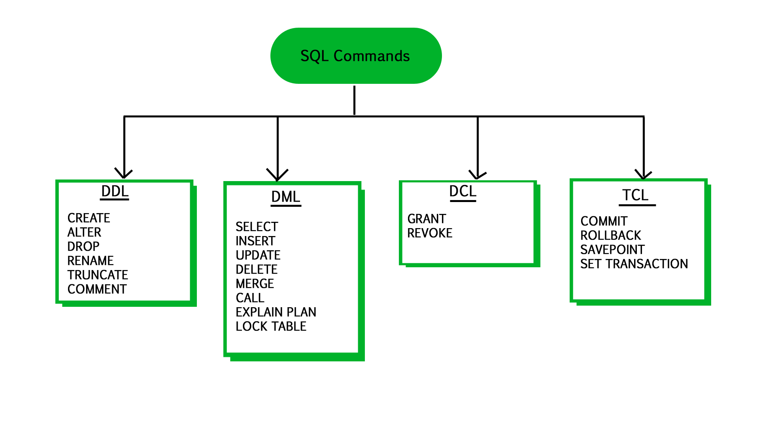
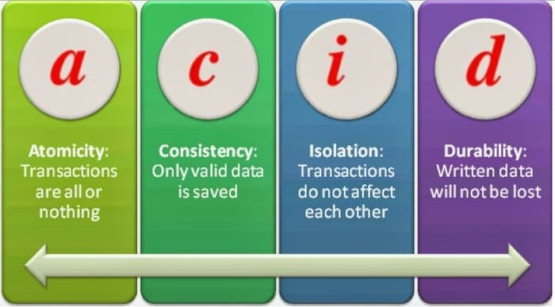
SQL COMMANDS AND ACID PROPERTIES
Transactions group a set of tasks into a single execution unit. Each transaction is complete when all the tasks in the group successfully complete. If any of
the tasks fail,the transaction fails. Therefore, a transaction has only two results: success or failure.
A : Each transaction is treated as a single "unit", with T or F
C : Bring the database from one valid state to another
I : Each task happens in isolation wrt other concurrent tasks
D : Data is not lost in case of system failure

Slide 9
DATABASES WITH NOSQL
NoSQL databases refers to not-only-SQL or non relational and is a database that provides a mechanism for storage and retrieval of data without using tables or relational structures.
Many were developed by companies like Google, Amazon, Yahoo, and Facebook that sought better ways to store content or process data for massive websites.
NoSQL databases are also used for handling big data, where the facilities provided by traditional databases for storage and processing are inadequate.
NoSQL databases can be scaled horizontally across hundreds or thousands of servers.This horizontal scaling is referred to as scaling-out.
NoSQL databases do not follow a predefined structure or schema for storing the data and hence they can work on different types of data like structured, semi-structured, unstructured and polymorphic data.
There are a lot of open source NoSQL databases available today with MongoDB topping the list.Other open source NoSQL databases include Cassandra,CouchDB,HBase,OrientDB,etc

Slide 10
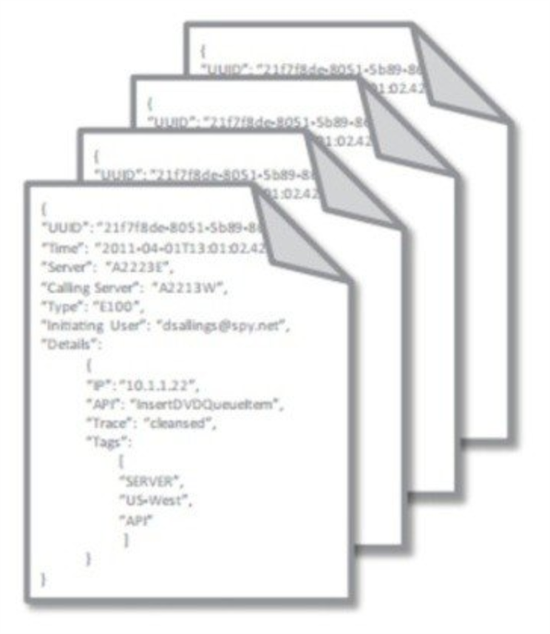
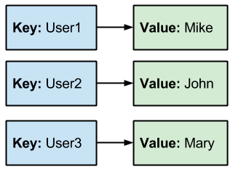
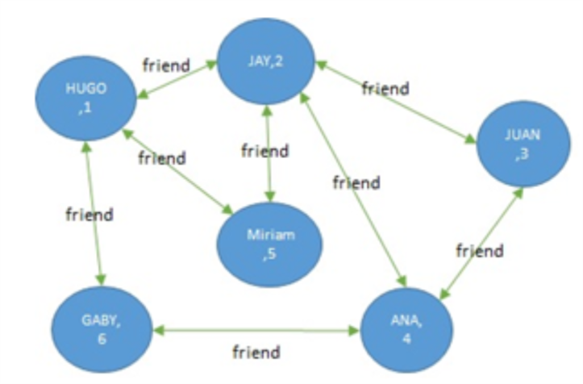
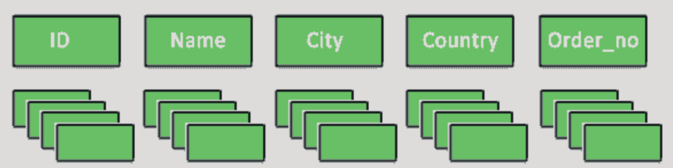
Types of NoSQL Databases
There are 4 different types of NoSQL databases, where each type solves a problem that cannot be solved by relational databases. Actual implementations are usually combinations of these.The 4 types are:
Key-value store
Document store
Column-oriented database
Graph database

Slide 11
DIFFERENCES BETWEEN SQL AND NOSQL
NoSQL is a Non-relational database likely to be more document and distributed than structured (Non-relational database has a document-oriented or distributed storage which doesn’t require any table structure.)
NoSQL databases have a dynamic schema for document type or unstructured data
NoSQL databases are horizontally scalable
NoSQL uses the collection of documents which is also known as UnQL (Unstructured Query Language).
SQL Database is a Relational Database and a structured one (Relational database - strictly adheres relations where it is divided into the set of rows and columns to store data often named as tables)
SQL Databases have a well-designed pre-defined schema.
SQL databases are vertically scalable
SQL uses structured query language for defining data

Slide 12
DIFFERENCES BETWEEN SQL AND NOSQL
There is no hierarchical data storage for SQL
SQL might require doing some changes like backfilling data, altering schemas.
SQL has a standard interface for handling complex queries, it would be great to deal with complex queries.
NoSQL uses hierarchical data storage
We can easily add the new data in NoSQL without requiring prior steps
We don’t have any standard interface in NoSQL, so it’s quite difficult to handle complex queries in NoSQL.

Slide 13

Thanks!
Contact us:
Your Company
123 Your Street
Your City, ST 12345
no_reply@example.com
www.example.com

